Slide 1
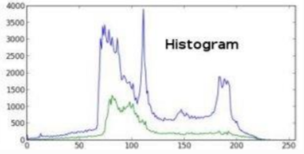
HISTOGRAM PROCESSING __BY UZMA SIDDIQUI MSC(IT)/15

Slide 2
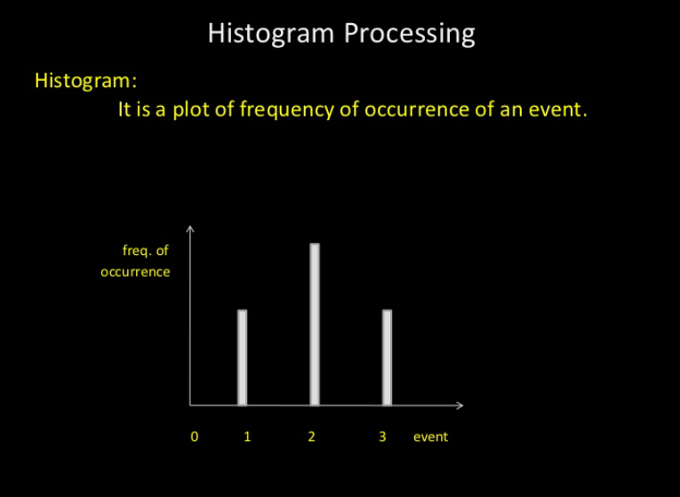

Slide 3
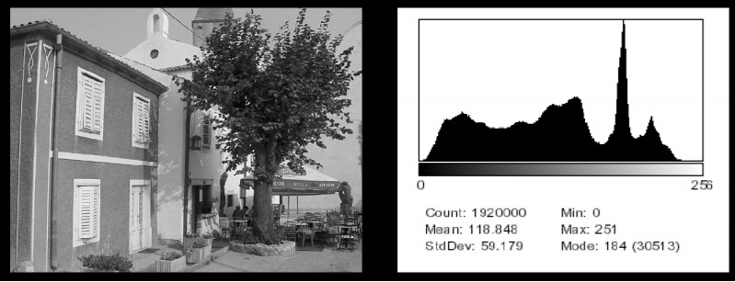
Histograms
Histograms plots how many times (frequency) each intensity value in image occurs
Example:
Image (left) has 256 distinct gray levels (8 bits)
Histogram (right) shows frequency (how many times) each gray level occurs

Slide 4
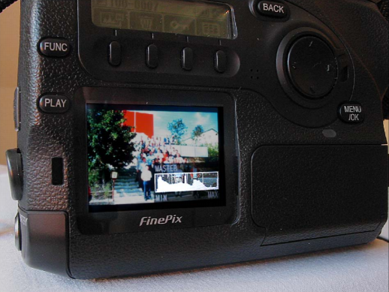
Histograms
Many cameras display real time histograms of scene
Helps avoid taking over‐exposed pictures
Also easier to detect types of processing previously applied to image

Slide 5
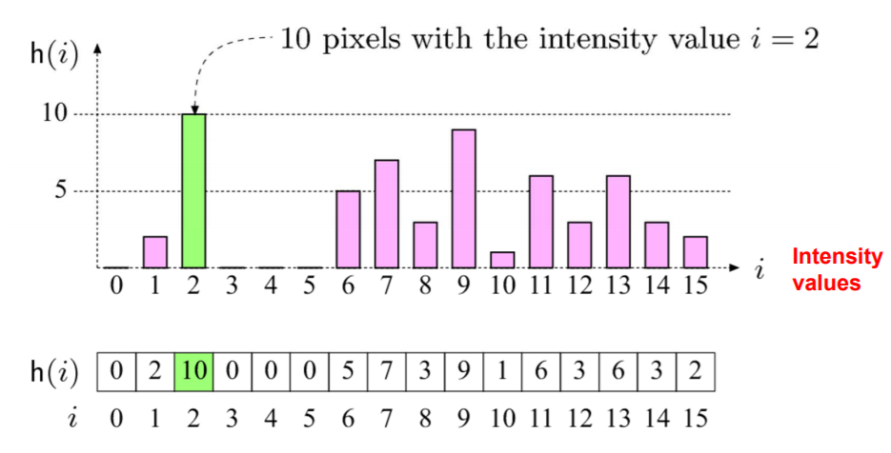
Histograms
E.g.for k=16, 10 pixels have intensity value = 2
Histograms: only statistical information
No indication of location of pixels

Slide 6

Histograms
Different images can have same histogram
3 images below have same histogram
Half of pixels are gray, half are white
Same histogram = same statisics
Distribution of intensities could be different
Can we reconstruct image from histogram? No!

Slide 7
Histograms
Histograms help detect image acquisition issues
Problems with image can be identified on histogram
Over and under exposure
Brightness
Contrast
Dynamic Range
Point operations can be used to alter histogram.
E.g
Addition
Multiplication
Exp and Log
Intensity Windowing (Contrast Modification)

Slide 8

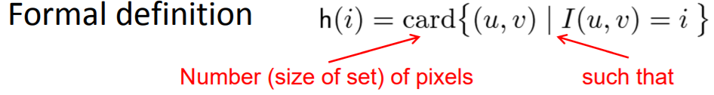
So, a histogram for a grayscale image with intensity values in range would contain exactly K entries
E.g. 8‐bit grayscale image, K = 28 = 256
Each histogram entry is defined as: h(i) = number of pixels with intensity I for all 0 < i < K.
E.g: h(255) = number of pixels with intensity = 255

Slide 9
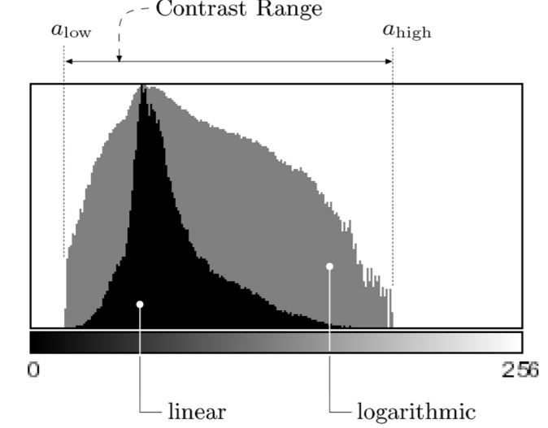
Interpreting Histograms
Log scale makes low values more visible
Difference between darkest and lightest

Slide 10
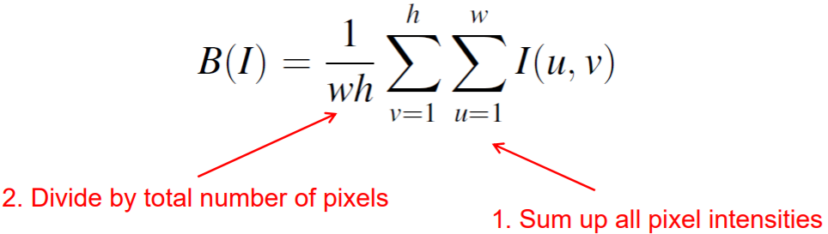
Image Brightness
Brightness of a grayscale image is the average intensity of all pixels in image

Slide 11
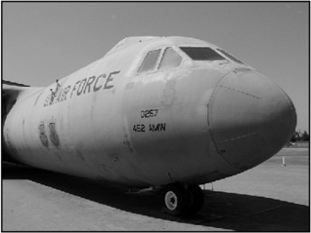
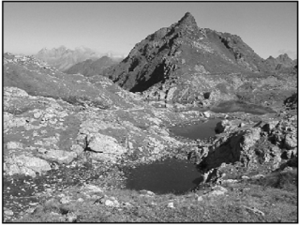
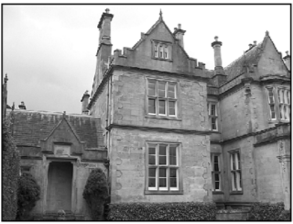
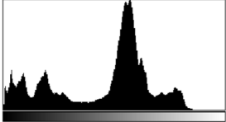
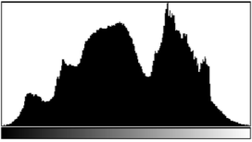
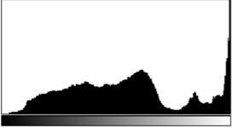
Detecting Bad Exposure using Histograms
Underexposed, Properly Overexposed, Exposed Exposure? Are intensity values spread (good) out or bunched up (bad)
Underexposed Properly Exposed Overexposed

Slide 12
Image Contrast
The contrast of a grayscale image indicates how easily objects in the image can be distinguished
High contrast image: many distinct intensity values
Low contrast: image uses few intensity values

Slide 13
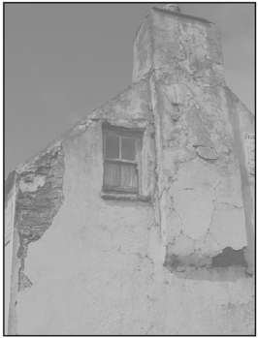
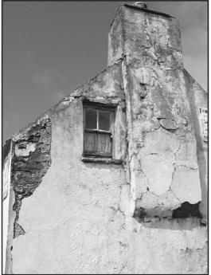
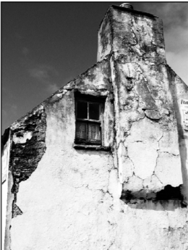
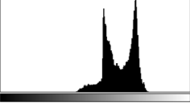
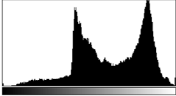
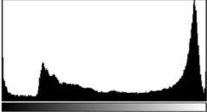
Histograms and Contrast
Good Contrast? Widely spread intensity values + large difference between min and max intensity values
Low contrast Normal contrast High contrast

Slide 14
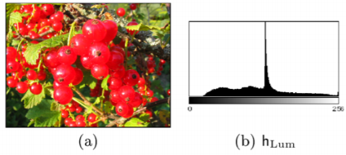
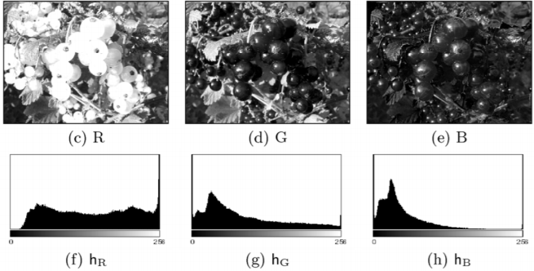
Color Image Histograms
Two types:
Intensity histogram:
Convert color image to gray scale
Display histogram of gray scale
2. Individual Color Channel Histograms:
3 histograms (R,G,B)

Slide 15
Color Image Histograms
Both types of histograms provide useful information about lighting, contrast, dynamic range and saturation effects
No information about the actual color distribution!
Images with totally different RGB colors can have same R, G and B histograms
Solution to this ambiguity is the Combined Color Histogram.

Slide 16
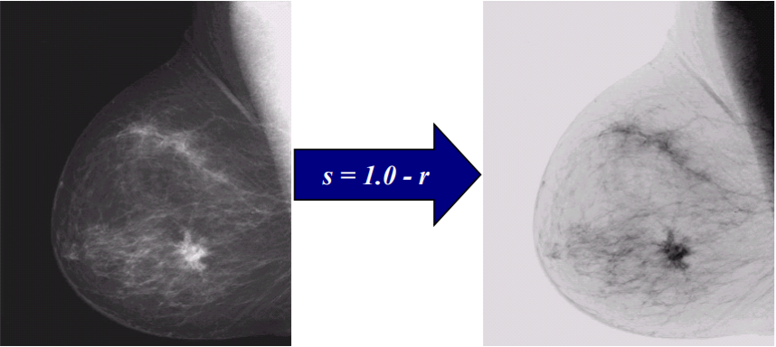
Image Negatives (Inverted Images)
Image negatives useful for enhancing white or grey detail embedded in dark regions of an image
Note how much clearer the tissue is in the negative image of the mammogram below
Orignal image Negative image

Slide 17
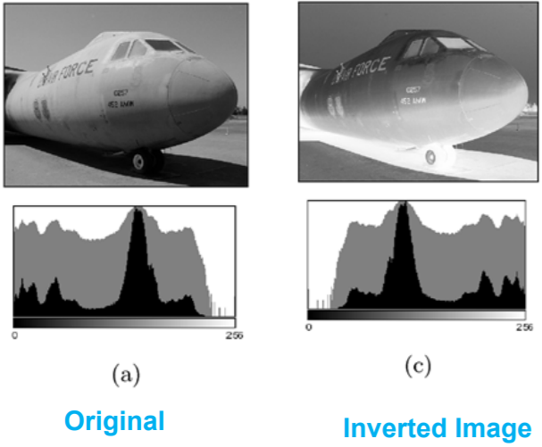
Inverting Images
2 steps
Multiple intensity by ‐1
2. Add constant (e.g. amax) to put result in
range [0,amax]
Implemented as ImageJ method
invert( )

Slide 18


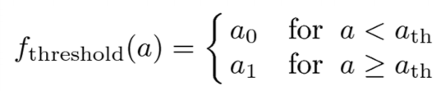

Thresholding
histogram has wide use in thresholding. This is mostly used in computer vision.
Input value below threshold
Input value above threshold
Converts greyscale image to binary image (binarization) if
• Implemented as imageJ method threshold( )

Slide 19
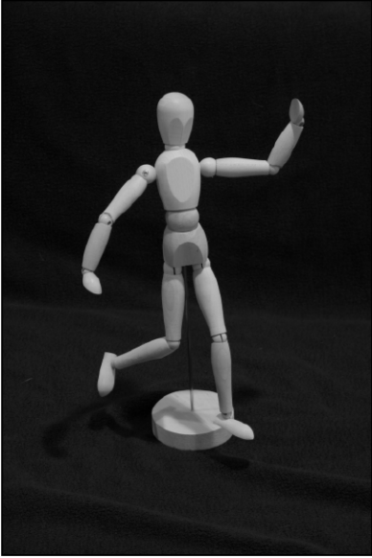
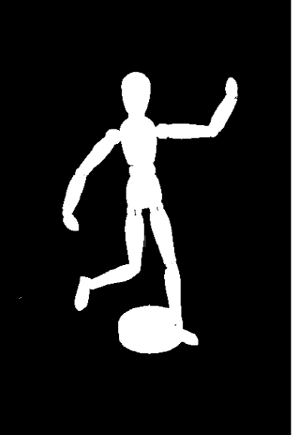
Thresholding Example
Orignal Image Threshold Image

Slide 20
Histogram Processing Techniques
Histogram Sliding
In Histogram sliding, the complete histogram is shifted towards rightwards or leftwards. When a histogram is shifted towards the right or left, clear changes are seen in the brightness of the image.
The brightness of the image is defined by the intensity of light which is emitted by a particular light source.

Slide 21
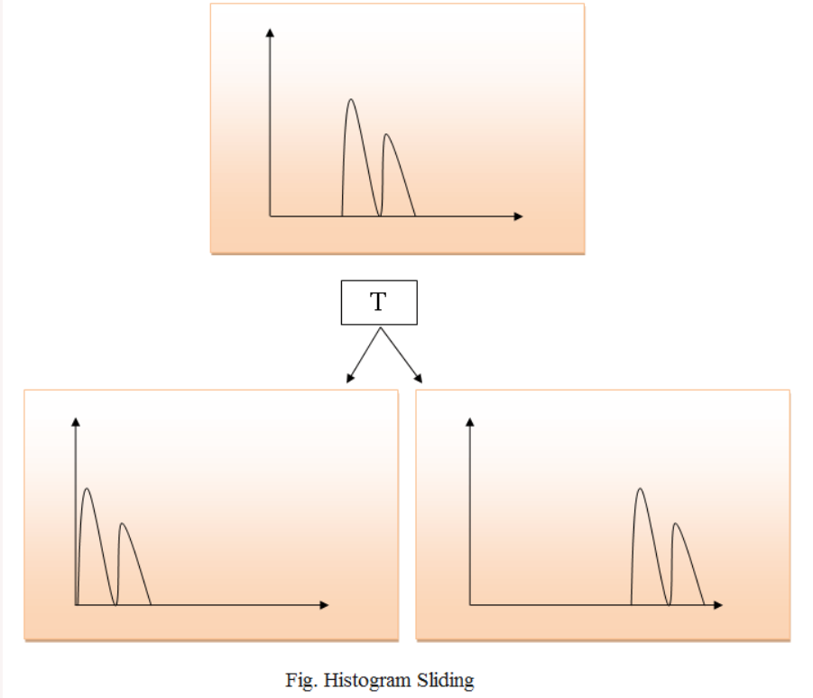

Slide 22
Histogram Stretching
Contrast of an image is increased.
The contrast of an image is defined between the maximum and minimum value of pixel intensity.
If we want to increase the contrast of an image, histogram of that image will be fully stretched and covered the dynamic range of the histogram.
From histogram of an image, we can check that the image has low or high contrast.

Slide 23
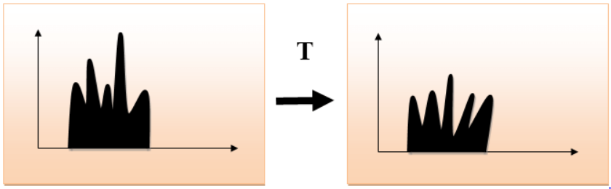
Histogram Stretching:

Slide 24
Histogram Equalization
Used for equalizing all the pixel values of an image. Transformation is done in such a way that uniform flattened histogram is produced.
To increases the dynamic range of pixel values and makes an equal count of pixels at each level which produces a flat histogram with high contrast image.
While stretching histogram, the shape of histogram remains the same whereas in Histogram equalization, the shape of histogram changes and it generates only one image.

Slide 25
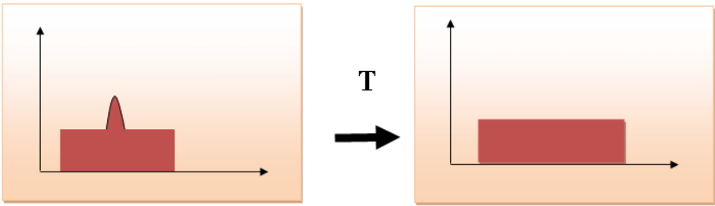
Histogram Equalization:

Slide 26
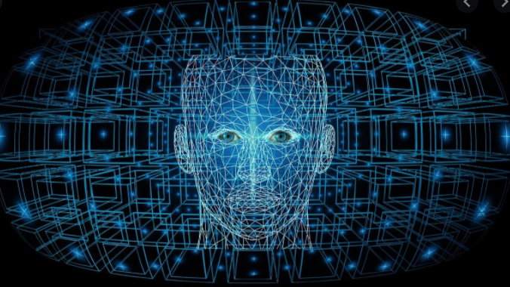
THANKYOU!

